Slide 1
Magist:
Is it a good partner for Eniac?
Group 5 (Dmitriy, Florian, Marcus, Weiling)
Data Science Boot Camp

Slide 2
Main questions
Is Magist a good fit for high-end tech products?
Are orders delivered on time?

Slide 3
Tech products on Magist
Tech products
Expensive tech products (price > average)
Product category | Sales amount | Sales %
Computers accessories | 7827 | 6.95
Telephony | 4545 | 4.03
Electronics | 2767 | 2.46
Consoles games | 1137 | 1.01
Fixed telephony | 264 | 0.23
Computers | 203 | 0.18
Tablets printing image | 83 | 0.07
PC gamer | 9 | 0.01
Sum | 16835 | 14.94
Product category | Sales %
Computers accessories | 2.25
Telephony | 0.58
Consoles games | 0.28
Electronics | 0.27
Computers | 0.18
Fixed telephony | 0.09
PC gamer | 0.01
Tablets printing image | 0.00
Sum | 3.7

Slide 4
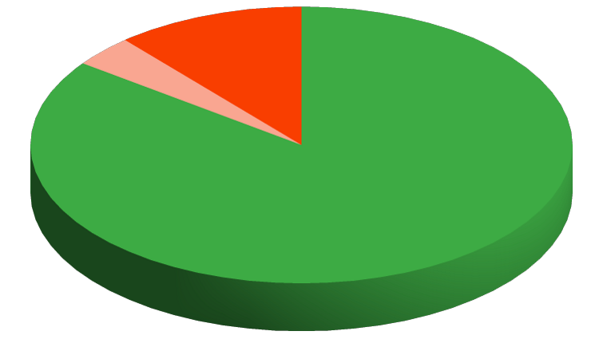
Tech products on Magist
Low-cost tech products
Non-tech products
Expensive tech products

Slide 5
Revenue of sellers
Number of sellers:
3095
Average monthly revenue of all sellers:
158,62 € (828.35 R$)
Average monthly revenue of sellers from tech products:
150,98 € (788.44 R$)

Slide 6
Delivery time
Average delivery time: 12.5 days
Orders delivered on time
Number on time | Total number | Percent on time
89810 | 99441 | 90.3

Slide 7
Conclusions
Magist NOT a good fit for Eniac
Portion of tech products is little
Revenue of tech products sellers is small
10% of orders are delivered with delays

Slide 8
Thank you :)

